Slide 1
Explainable AI [Model Interpretability]
Shamir Alavi
SC&D, ITAS
Dec 19’19

Slide 2
Agenda: Objective
To explain what Explainable AI (XAI) is
To demonstrate how XAI looks like
To discuss limitations and challenges of the current state-of-the-art

Slide 3
Agenda: Demos
Demo 1: Explaining Tax Filer Status
Demo 2: Explaining Sentiment Analysis

Slide 4
What is AI? (recap)

Slide 5
What is AI? [what is machine learning?]
A capability for a computer/machine to mimic how humans make decisions
Makes a random guess at first
Someone tells it that it is wrong [tech: supervised learning]
Goes back to change its decision making process
Rinse and repeat until it gets it right [tech: backpropagation in NN]
Uses that info to make decisions on new data

Slide 6
How does it work? [the methodology]
Gather data
Clean it (because real data has garbage) [tech: preprocessing]
Extract interesting properties [tech: feature extraction]
Teach a machine to find patterns [tech: training]
Let it write the if statements for you ☺
Analyze results and fix things [tech: validation]
Test and report [tech: testing]

Slide 7
How does it work? [the methodology]
Gather data
Clean it (because real data has garbage) [tech: preprocessing]
Extract interesting properties [tech: feature extraction]
Teach a machine to find patterns [tech: training]
Let it write the if statements for you ☺
Analyze results and fix things [tech: validation]
Test and report [tech: testing]
98% test accuracy…job well done!!!

Slide 8

How does it work? [the methodology]
BIAS/VARIANCE
TESTED
Gather data
Clean it (because real data has garbage) [tech: preprocessing]
Extract interesting properties [tech: feature extraction]
Teach a machine to find patterns [tech: training]
Let it write the if statements for you ☺
Analyze results and fix things [tech: validation]
Test and report [tech: testing]
98% test accuracy…job well done!!!

Slide 9



How does it work? [the methodology]
BIAS/VARIANCE
TESTED
100% SAFE
Gather data
Clean it (because real data has garbage) [tech: preprocessing]
Extract interesting properties [tech: feature extraction]
Teach a machine to find patterns [tech: training]
Let it write the if statements for you ☺
Analyze results and fix things [tech: validation]
Test and report [tech: testing]
98% test accuracy…job well done!!!
Ethically
sourced
APPROVED

Slide 10
What if the client asks…

Slide 11
Why should I trust you? [skeptical client/supervisor/boss]
98% accuracy but I don’t know how
I don’t understand what’s under the hood
I don’t have time to learn maths again
It has been always a black box
I just want to see something that I can relate to and understand visually

Slide 12
Why should I trust you? [skeptical client/supervisor/boss]
98% accuracy but I don’t know how
I don’t understand what’s under the hood
I don’t have time to learn maths again
It has been always a black box
I just want to see something that I can relate to and understand visually

Slide 13
Why should I trust you? [skeptical client/supervisor/boss]
98% accuracy but I don’t know how
I don’t understand what’s under the hood
I don’t have time to learn maths again
It has been always a black box
I just want to see something that I can relate to and understand visually
***EXPLANATION IS REQUIRED***

Slide 14
Explainable AI

Slide 15
Explainable AI
A framework to explain the outputs of an ML model
Helps models describe their decision-making process
Makes the explanation intuitive for us to understand

Slide 16
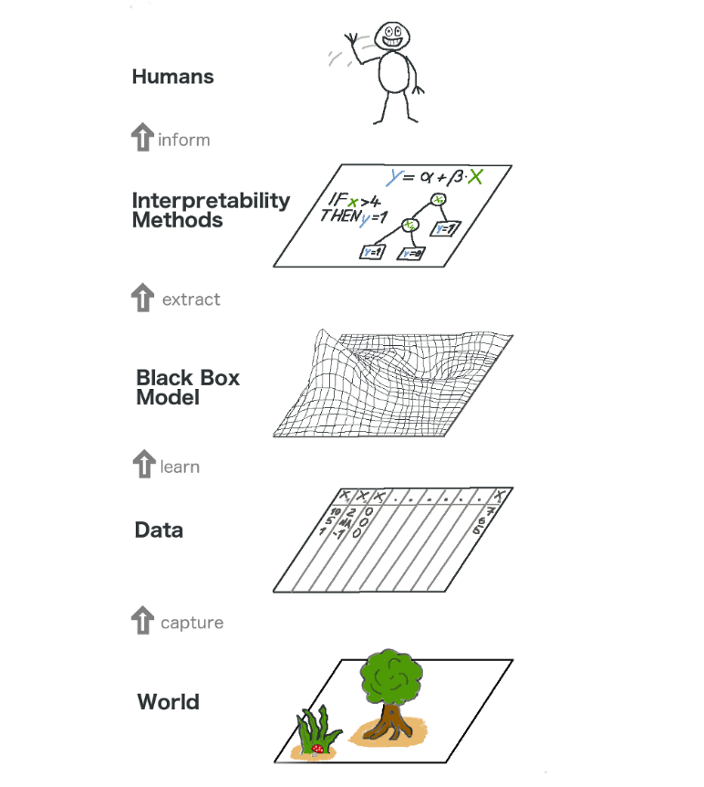
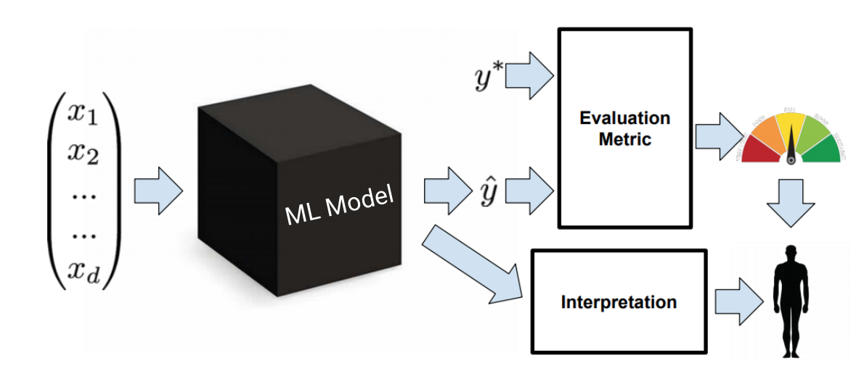
https://www.analyticsvidhya.com/blog/2019/08/decoding-black-box-step-by-step-guide-interpretable-machine-learning-models-python/
https://towardsdatascience.com/interpretable-machine-learning-1dec0f2f3e6b

Slide 17
Explainable AI
Let’s see it…

Slide 18
Demo 1 Explaining Tax Filer Status

Slide 19
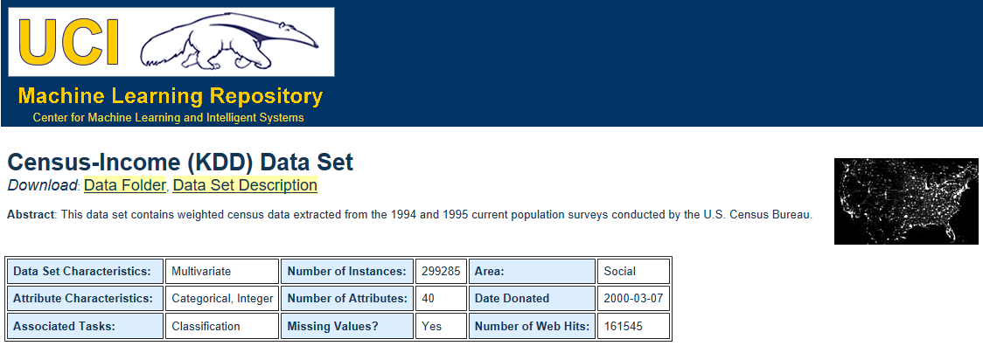
Demo 1: The dataset
Census-Income (USA, 1993-1994)
https://archive.ics.uci.edu/ml/datasets/Census-Income+(KDD)

Slide 20
Demo 1: The dataset
Let’s look at some dummy data (but it’s close to original):
Age | Class Of Worker | Education | Marital_Status | Capital Gains | Capital Losses | Weeks_Worked_In_Year | Income <> $50000
35 | Private | Bachelors degree | Married-civilian spouse present | 1000 | 500 | 52 | more_than_50k
35 | Local government | Bachelors degree | Married-civilian spouse present | 0 | 0 | 52 | less_than_50k
42 | Self-employed-incorporated | Bachelors degree | Married-civilian spouse present | 0 | 0 | 50 | more_than_50k
42 | Self-employed-not incorporated | College but no degree | Married-civilian spouse present | 0 | 0 | 34 | less_than_50k

Slide 21
The original dataset
Notes:
Show dataset on excel

Slide 22
Demo 1: Objectives
Predict:
If the person is a tax filer or a non-filer (regardless of intent)
Explain
What made the ML model label the person as filer/non-filer

Slide 23
Visualizations – Demo 1
Notes:
For tech audience only

Slide 24
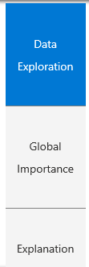
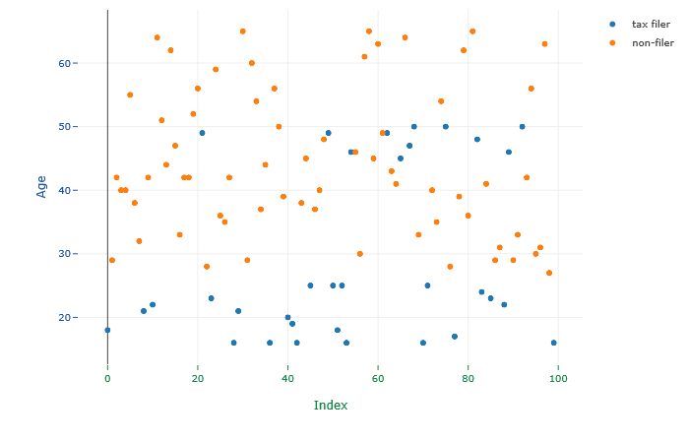
Global explanation (tax filing status prediction based on Age) Index: Each index is a person in the dataset

Slide 25


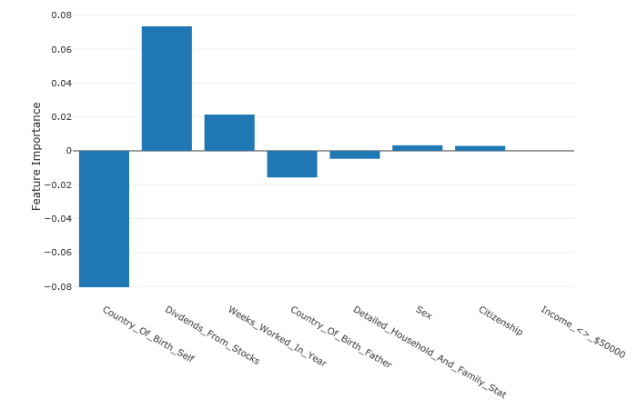
Local explanation (explanation for a specific person/citizen)

Slide 26
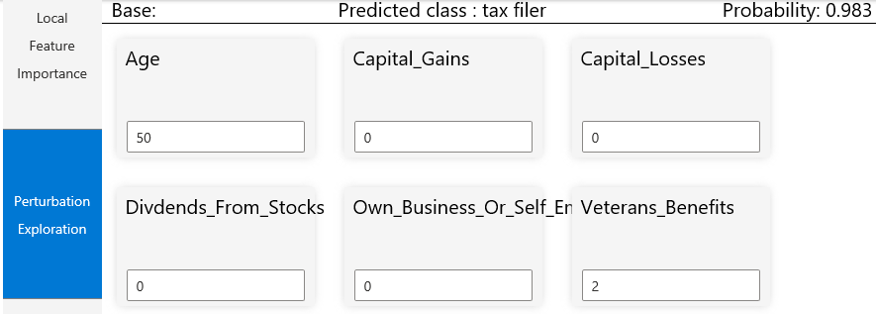
Local explanation (explanation for a specific person/citizen) The tool provides the ability to change the data to test changes in the model’s prediction
Original prediction

Slide 27
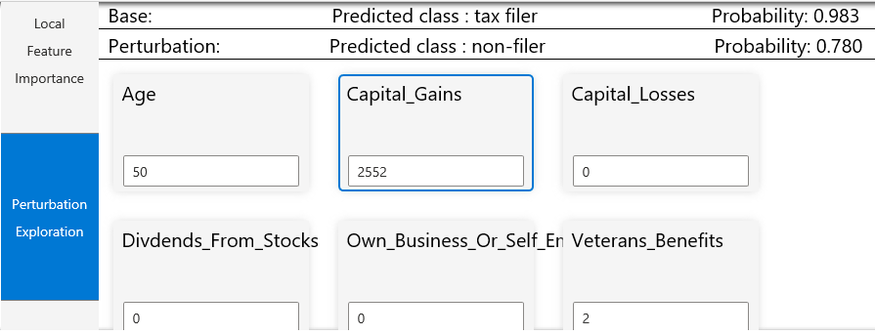
Local explanation (explanation for a specific person/citizen) The tool provides the ability to change the data to test changes in the model’s prediction
Prediction has changed because we modified the value in capital gains

Slide 28
Training
Notes:
For tech audience only

Slide 29
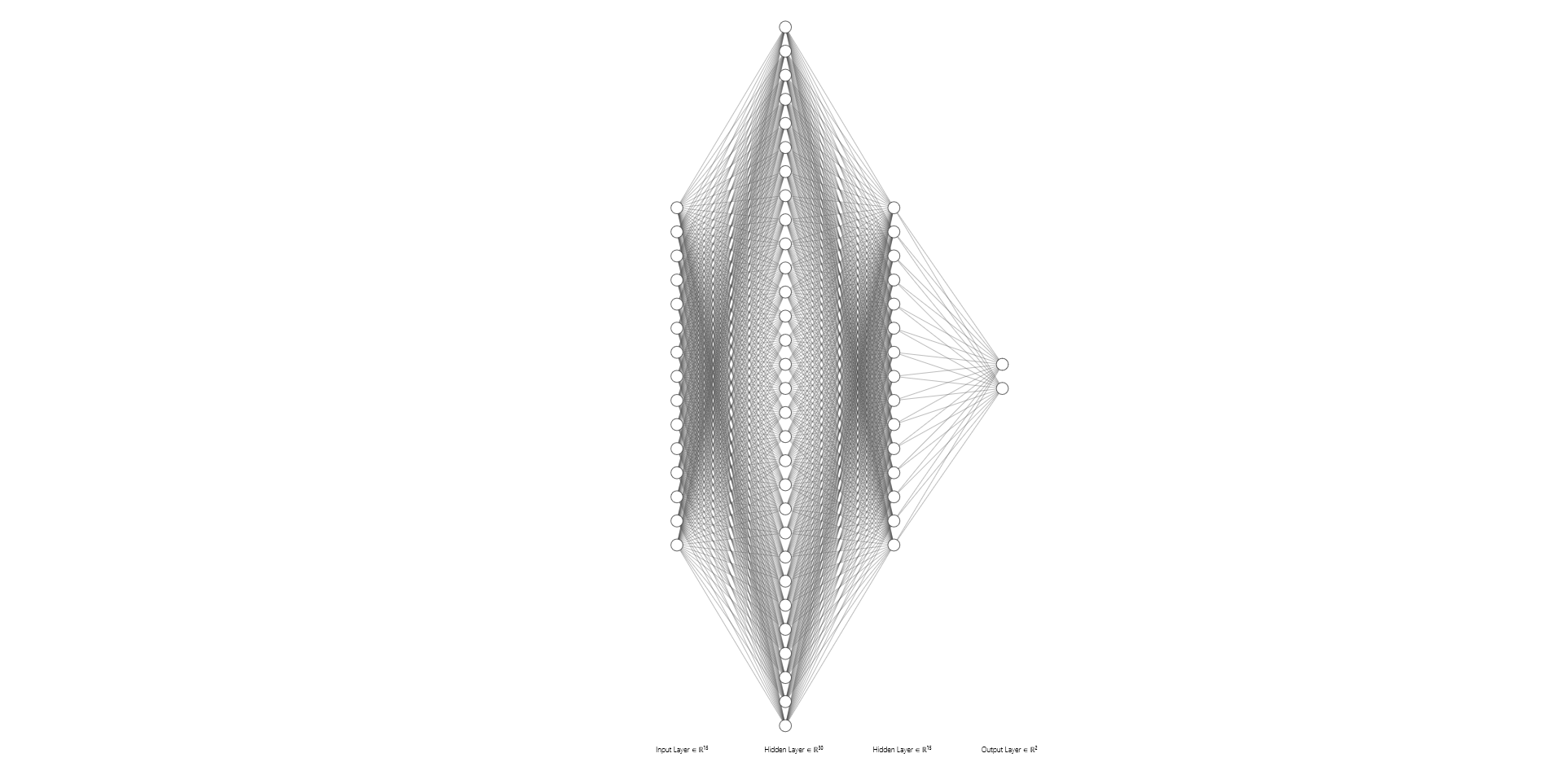
Neural Network Architecture [Fully connected network]
Notes:
For tech audience only

Slide 30
Explanation

Slide 31
Demo 2 Explaining Sentiment Analysis

Slide 32
Demo 2: Objectives
Predict:
The sentiment of an IMBD movie review post (positive/negative)
Explain
Why it is positive/negative
Also tested using some dummy comments in the demo

Slide 33
Visualizations – Demo 2
Notes:
For tech audience only

Slide 34
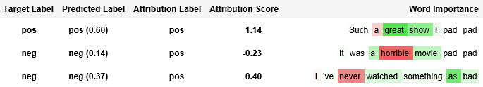
Original IMDB movie reviews

Slide 35
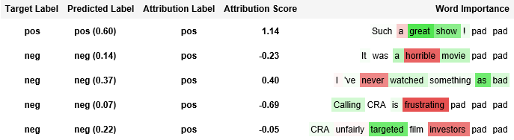
Added a couple of negative comments mimicking CRA’s tweeter feed

Slide 36
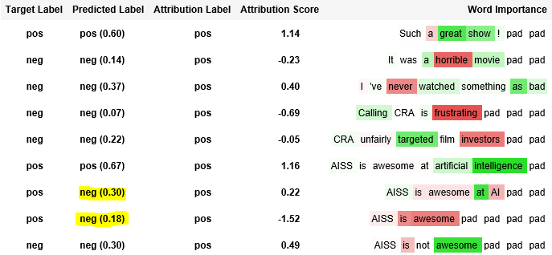
Added a dummy comments to test if the model is losing context

Slide 37
Training
Notes:
For tech audience only

Slide 38
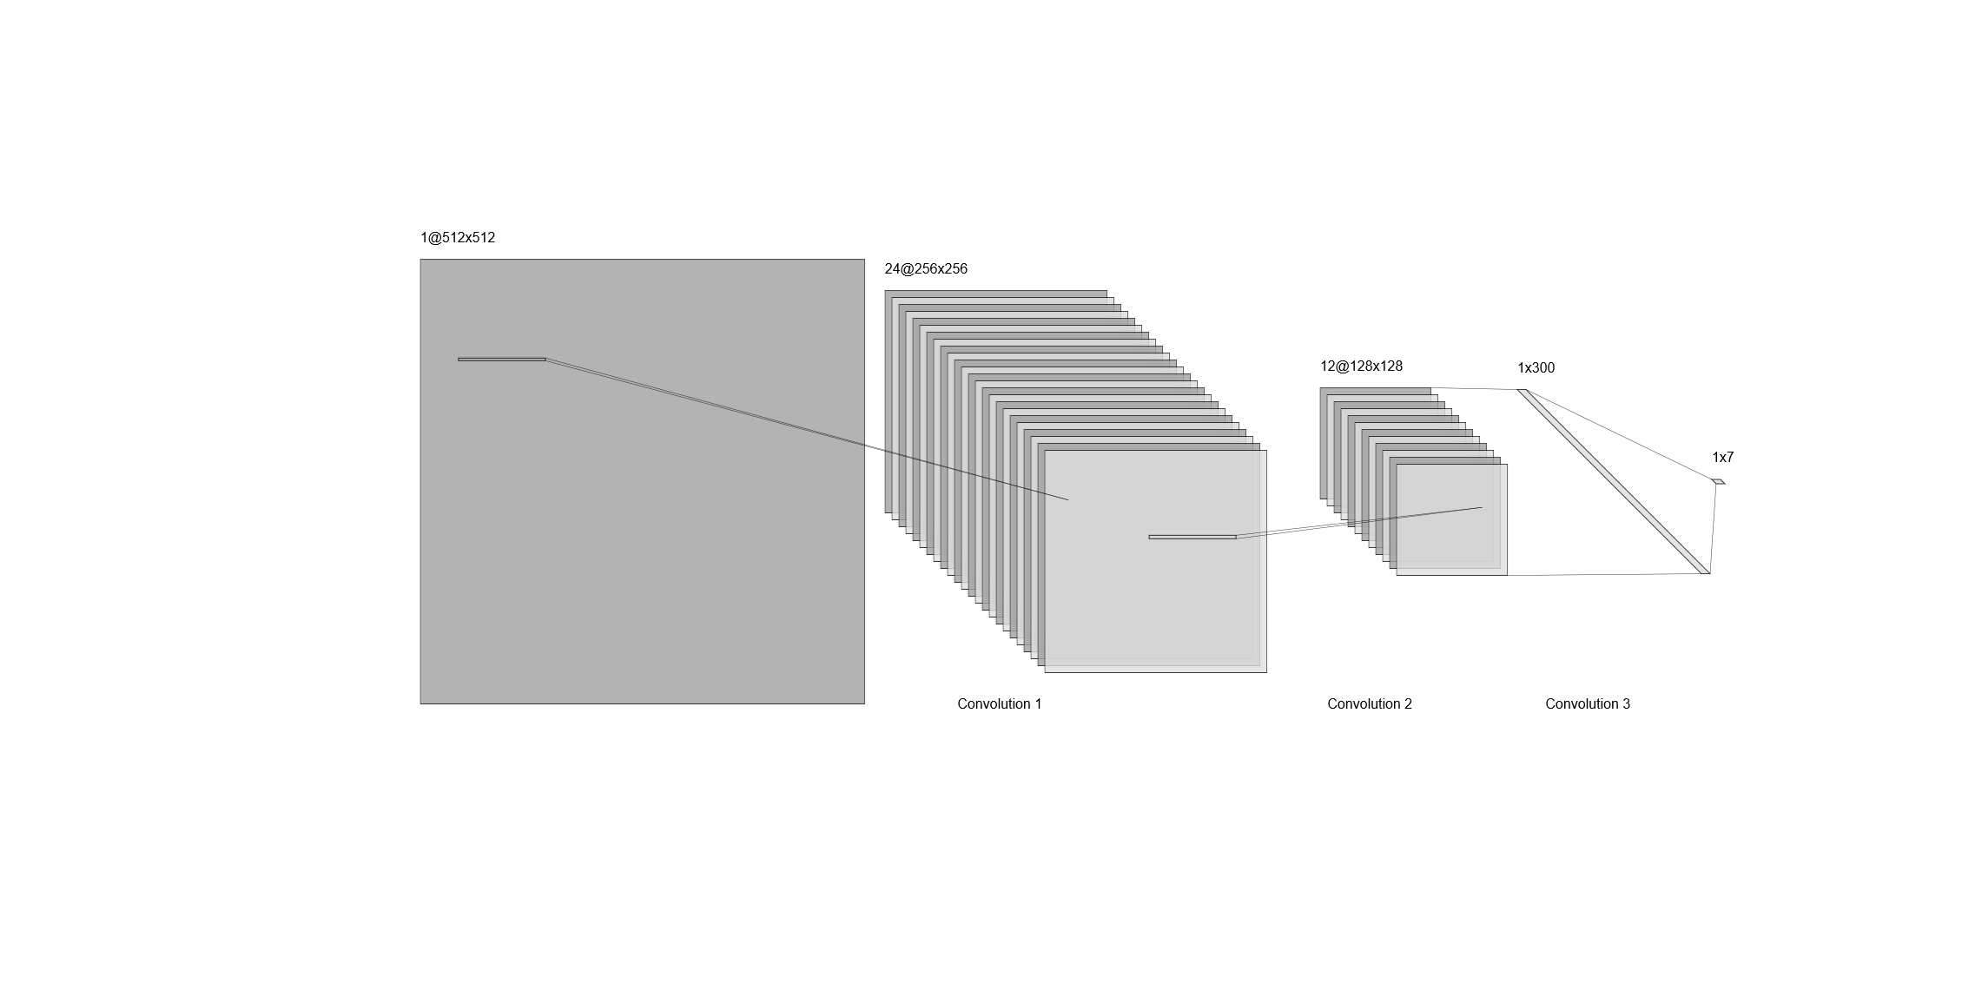
Convolutional Neural Network (CNN) [architecture]
Notes:
For tech audience, NOT an exact representation of the model architecture.

Slide 39
Explanation

Slide 40
XAI: Limitations of state-of-the-art
Still in experimental mode
Not intuitive enough for CRA-specific use cases
Steep learning curve for beginners in machine/deep learning

Slide 41
XAI: Next steps
Tax-filer status model:
get a better dataset (unclassified CRA data)
better training (parameter tuning, decode features)
better visualization
Sentiment analysis
Train on CRA twitter feed (only on incoming posts from taxpayers)
Try other deep learning algorithms (e.g. RNN)
Create a DevOps pipeline

Slide 42
Explainable AI (XAI)
XAI is a capability that can be added to a machine learning model
To explain what made the AI make a certain decision
Open source tools (Azure, Captum)

Slide 43
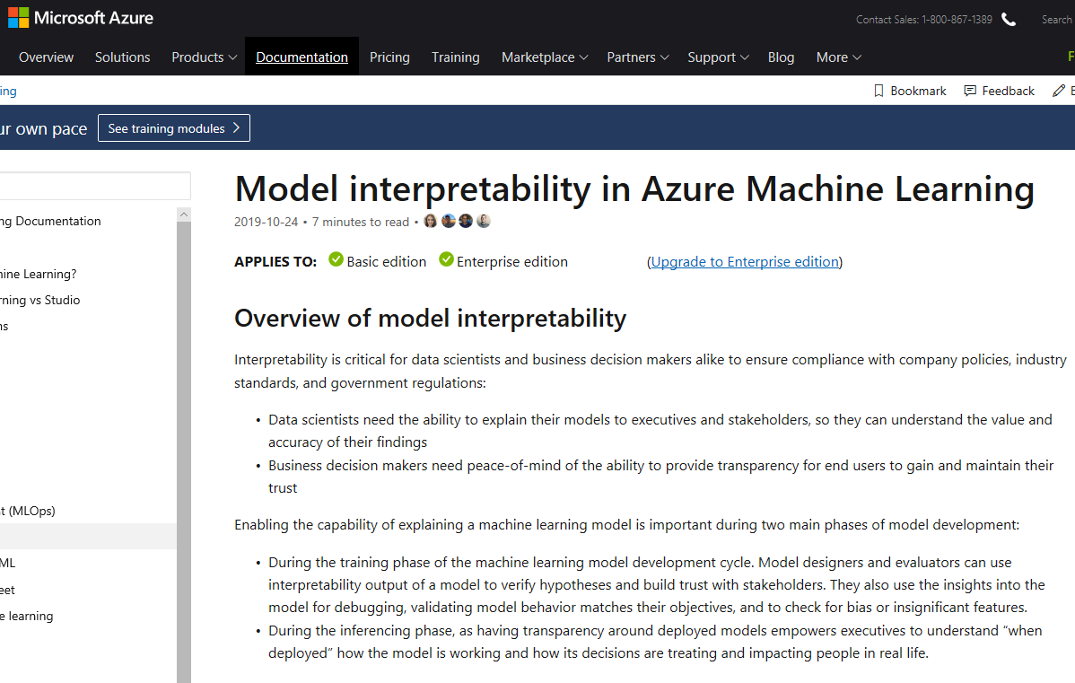
Explainable AI: MS Azure
https://docs.microsoft.com/en-ca/azure/machine-learning/service/how-to-machine-learning-interpretability

Slide 44
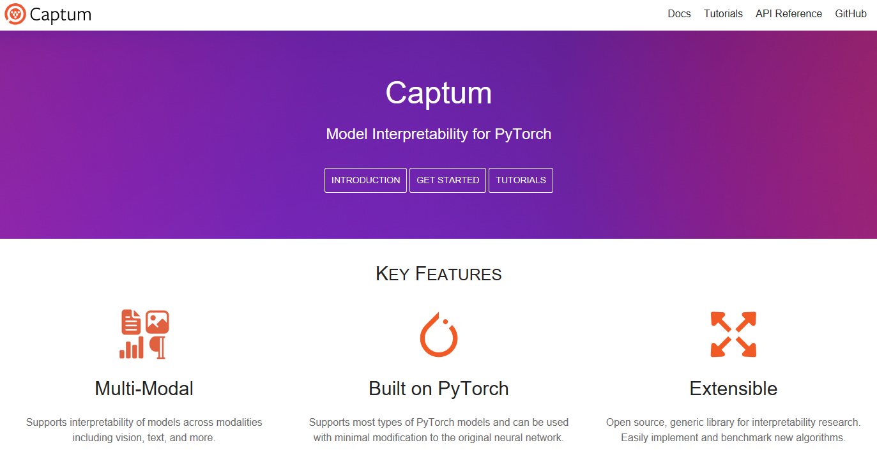
Explainable AI: Captum
https://captum.ai/

Slide 45
Thank you

